Slide 1

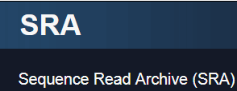
UNIT 2
LECTURE 2: DOWNLOAD SEQUENCE READS
Princess Rodriguez, PhD
MMG 232
Spring 2023

Slide 2
Today you will learn:
What is GEO?
Navigate through GEO and SRA
Make sense of the accession numbers, the data they hold, and how they fit together
How to download sequence reads (.fastq files) from SRA
Download and configure SRA Toolkit

Slide 3
What is GEO?
GEO (Gene Expression Omnibus) is an international public repository that archives and freely distributes microarray, next-generation sequencing, and other forms of high-throughput functional genomics data submitted by the research community
User-friendly
100’s of organisms and thousands of different expression analysis platforms

Slide 4
Submitting to GEO
Is a pre-requisite for publication of peer-reviewed research articles
Step-by-step process that requires sample data spreadsheets, raw data, and other submission forms

Slide 5
MIAME Compliant
Minimum information about a microarray experiment
Effort to standardize publicly available data
MAIME Checklist
Experimental Design
Samples used, extract preparation, and labeling
Measurement data and specifications

Slide 6
GEO Architecture
There are three types of GEO submitter records:
A Platform record describes an array or sequencer and, for array-based platforms, a data table defining the array template.
A Sample record describes the sample source, the protocols used in its analysis, and the expression data derived from it.
A Series record links together a group of related Samples and describes a whole study.
Together, this information makes up a GEO record that is assembled by the GEO staff. These records provide a coherent synopsis about the experiment and data collected.

Slide 7
GEO data retrieval
GEO data can be retrieved and analyzed in several ways:
To look at a particular GEO record for which you have the accession number, use the GEO accession box located on the GEO homepage or at the top of each GEO record.
To download data, see the various options described on the Download GEO data page.
To quickly locate data relevant to your interests, search GEO DataSets and GEO Profiles

Slide 8
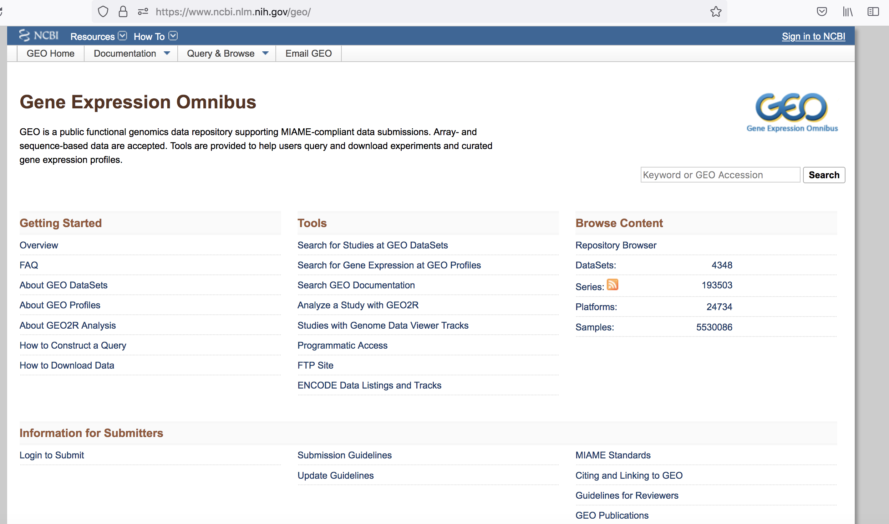
https://www.ncbi.nlm.nih.gov/geo/

Slide 9
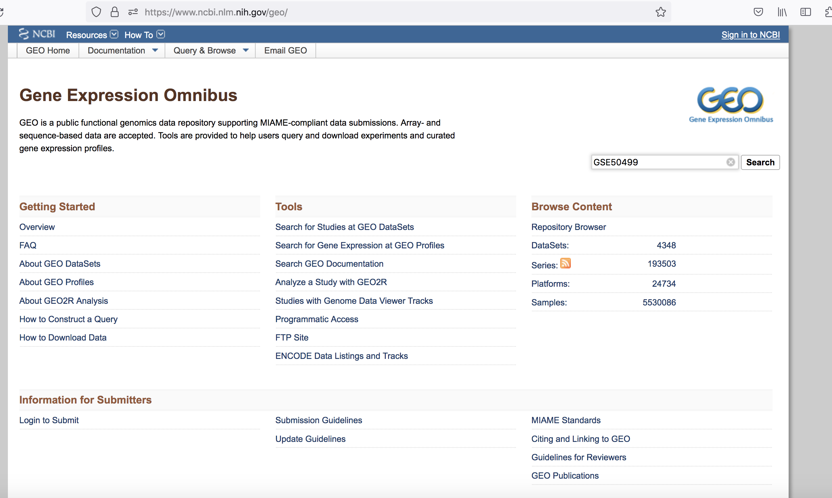
GSE50499

Slide 10
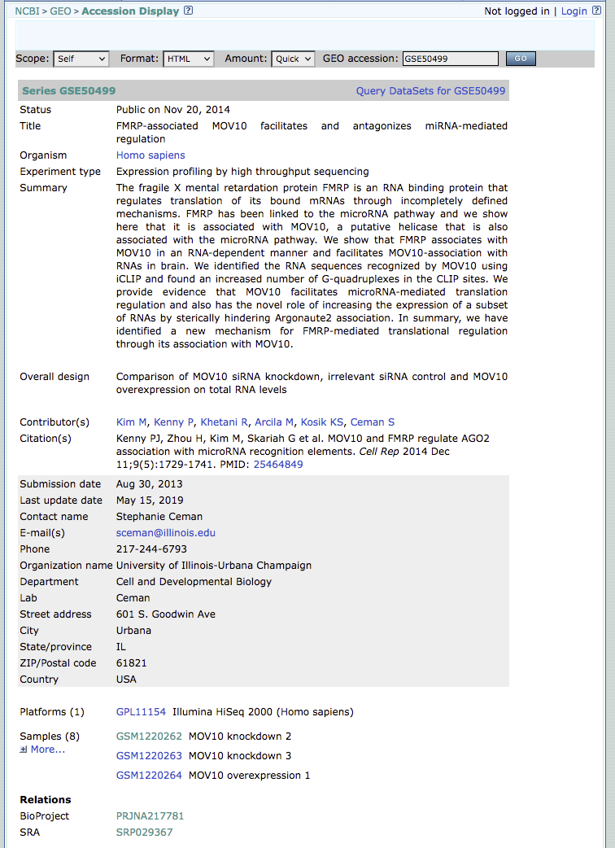

Slide 11
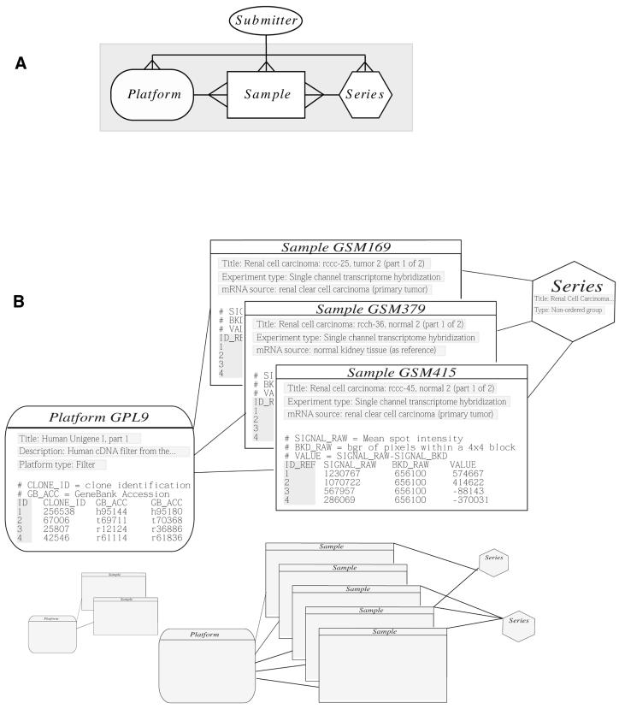
many
1
1
GSEXXXXX
GSMXXXXX
GPLXXXXX

Slide 12
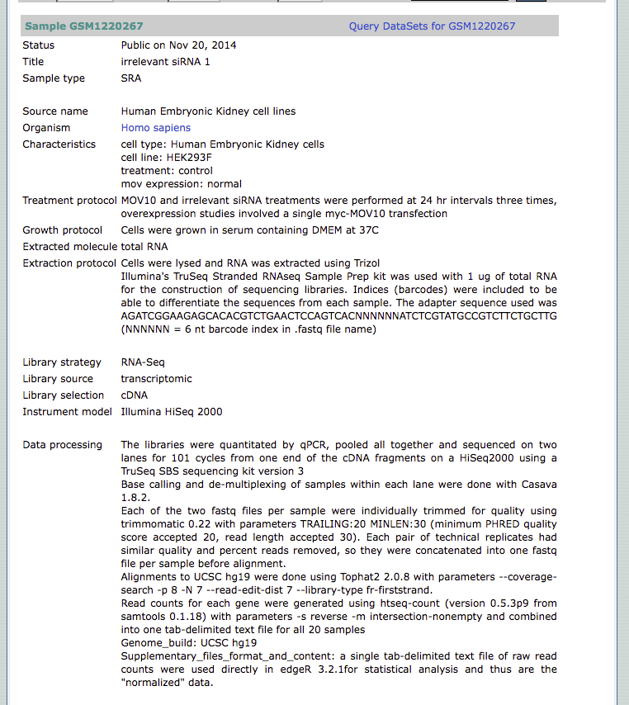

Slide 13
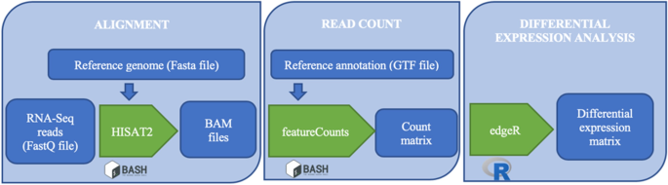

Slide 14
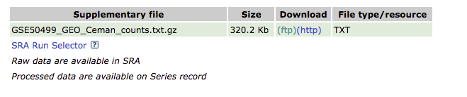
This assumes you completely understand the bioinformatic pipeline used and that it is still acceptable to current standards
Was the latest reference genome used?
Some aligners are outdated (ex. TopHat)

Slide 15
Research paper
(PUBMED)
SRA
(SRR, SRP)
GEO
(GSE, GSM, GPL)
NCBI

Slide 16
What is SRA?
The Sequence Read Archive (SRA) is an archive for high throughput sequencing data, publicly accessible, for the purpose of enhancing reproducibility in the scientific community.

Slide 17
There are levels of SRA entities and their accessions:
STUDY with accessions in the form of SRP, ERP, or DRP
SAMPLE with accessions in the form of SRS, ERS, or DRS
EXPERIMENT with accessions in the form of SRX, ERX, or DRX
RUN with accessions in the form of SRR, ERR, or DRR

Slide 18
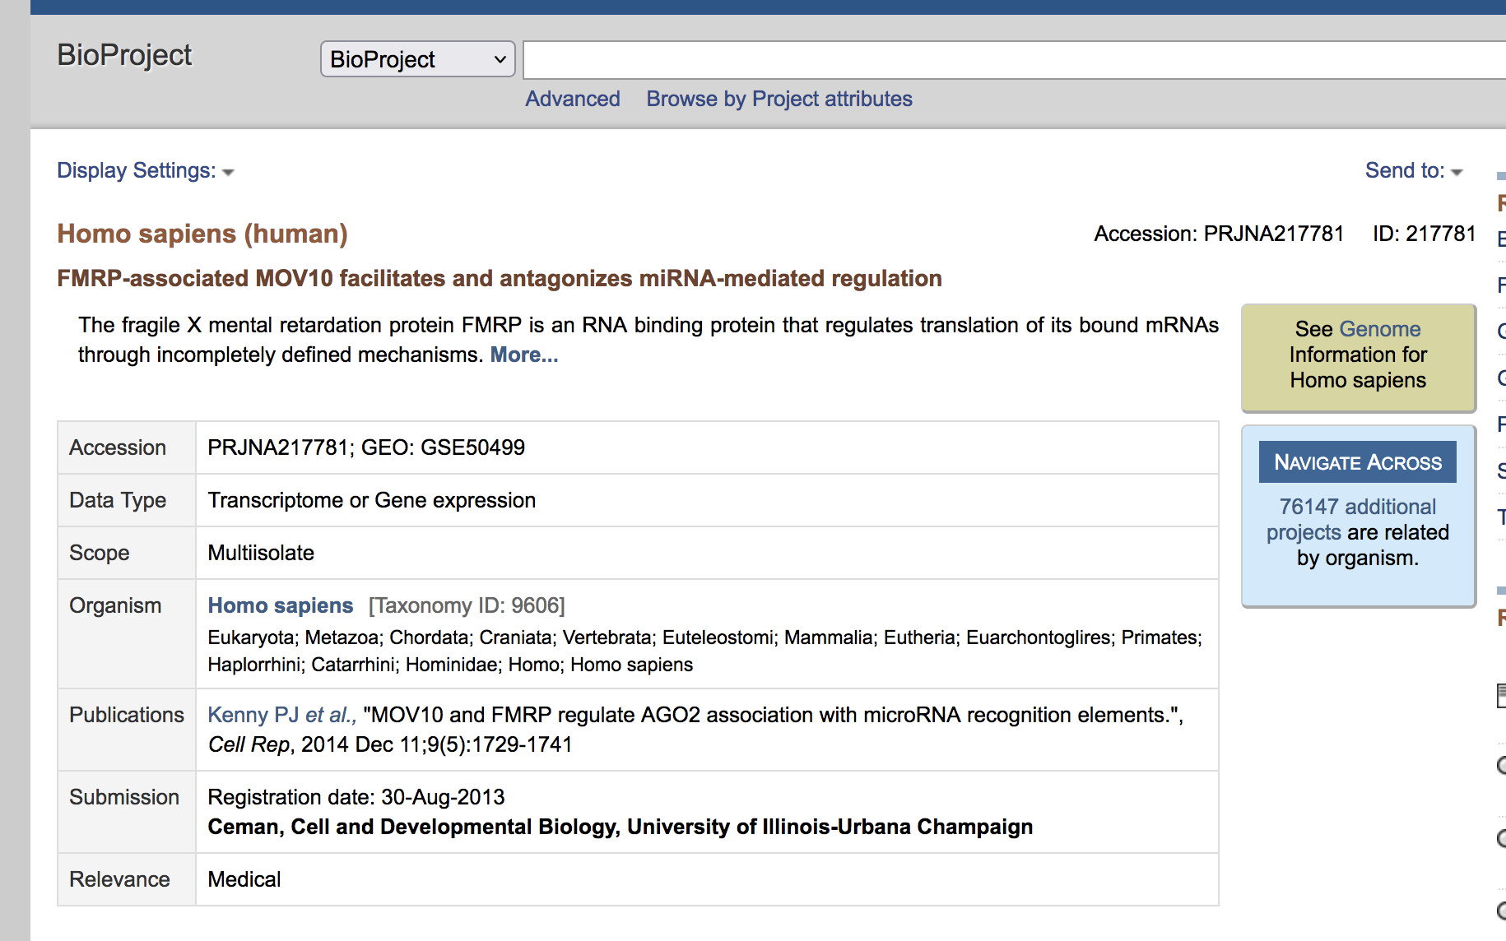
Sra HIERARCHY
Stands for | NCBI Prefix
BioProject | PRJNA123456
Notes:
Bioproject is a collection of biological data thats related to a single initiative. So you can think of the bioproject as a parent directory that’s going to hold all of the metadata, all of the sequencing information, and any information that may be related to the project.

Slide 19
Sra HIERARCHY
Stands for | NCBI Prefix
BioProject | PRJNA123456
Sequence Read Archive Study | SRP123456
Sequence Read Archive Experiment | SRX123456
Sequence Read Archive Run | SRR123456
Notes:
Then within the bioproject you have a single study, then within the study you could have multiple experiments.

Slide 20
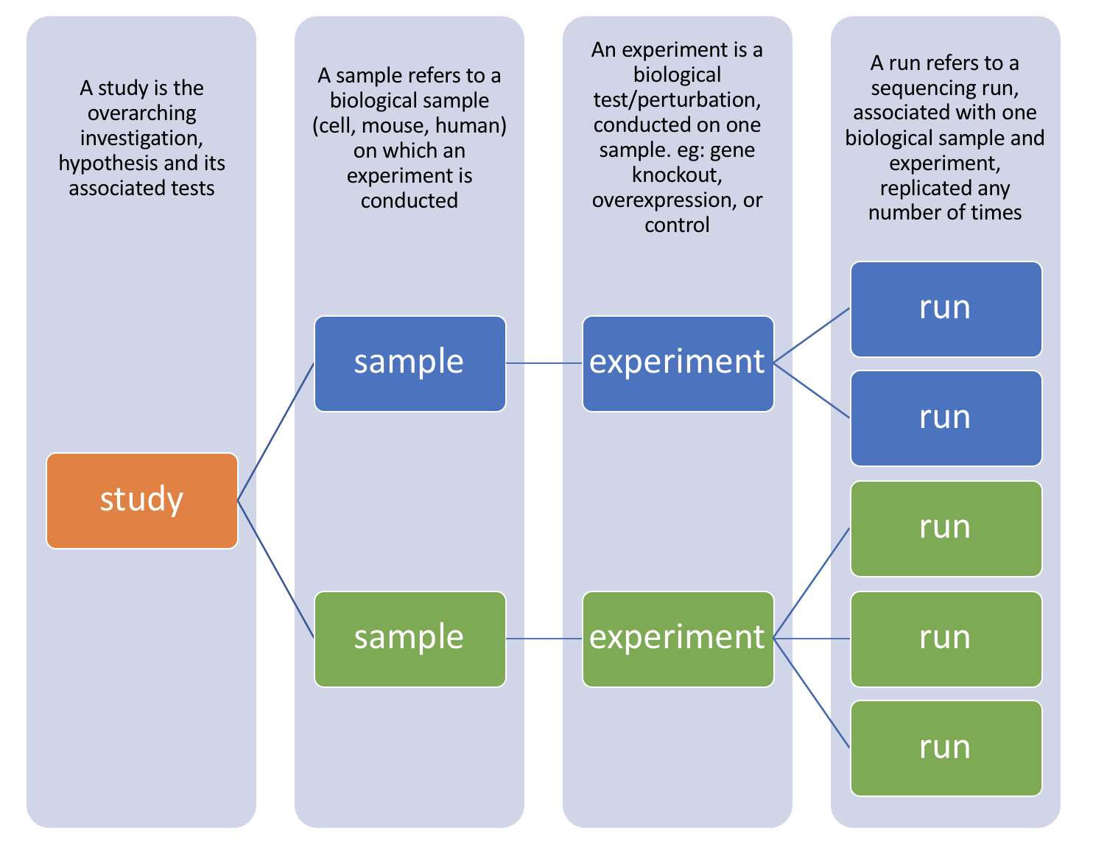
SRR1
SRR2
SRR3
SRR4
SRR5
Notes:
Most studies include multiple samples and a high number of replicates, it is useful to know how to download all the sequencing runs from all samples in a study, without having to hunt down and type in individual SRR numbers one by one.

Slide 21
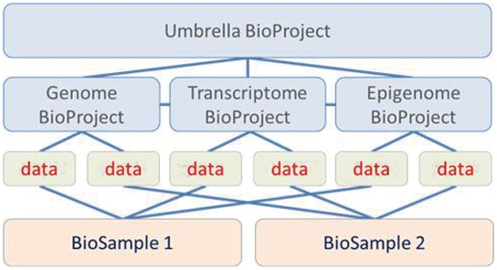

Slide 22
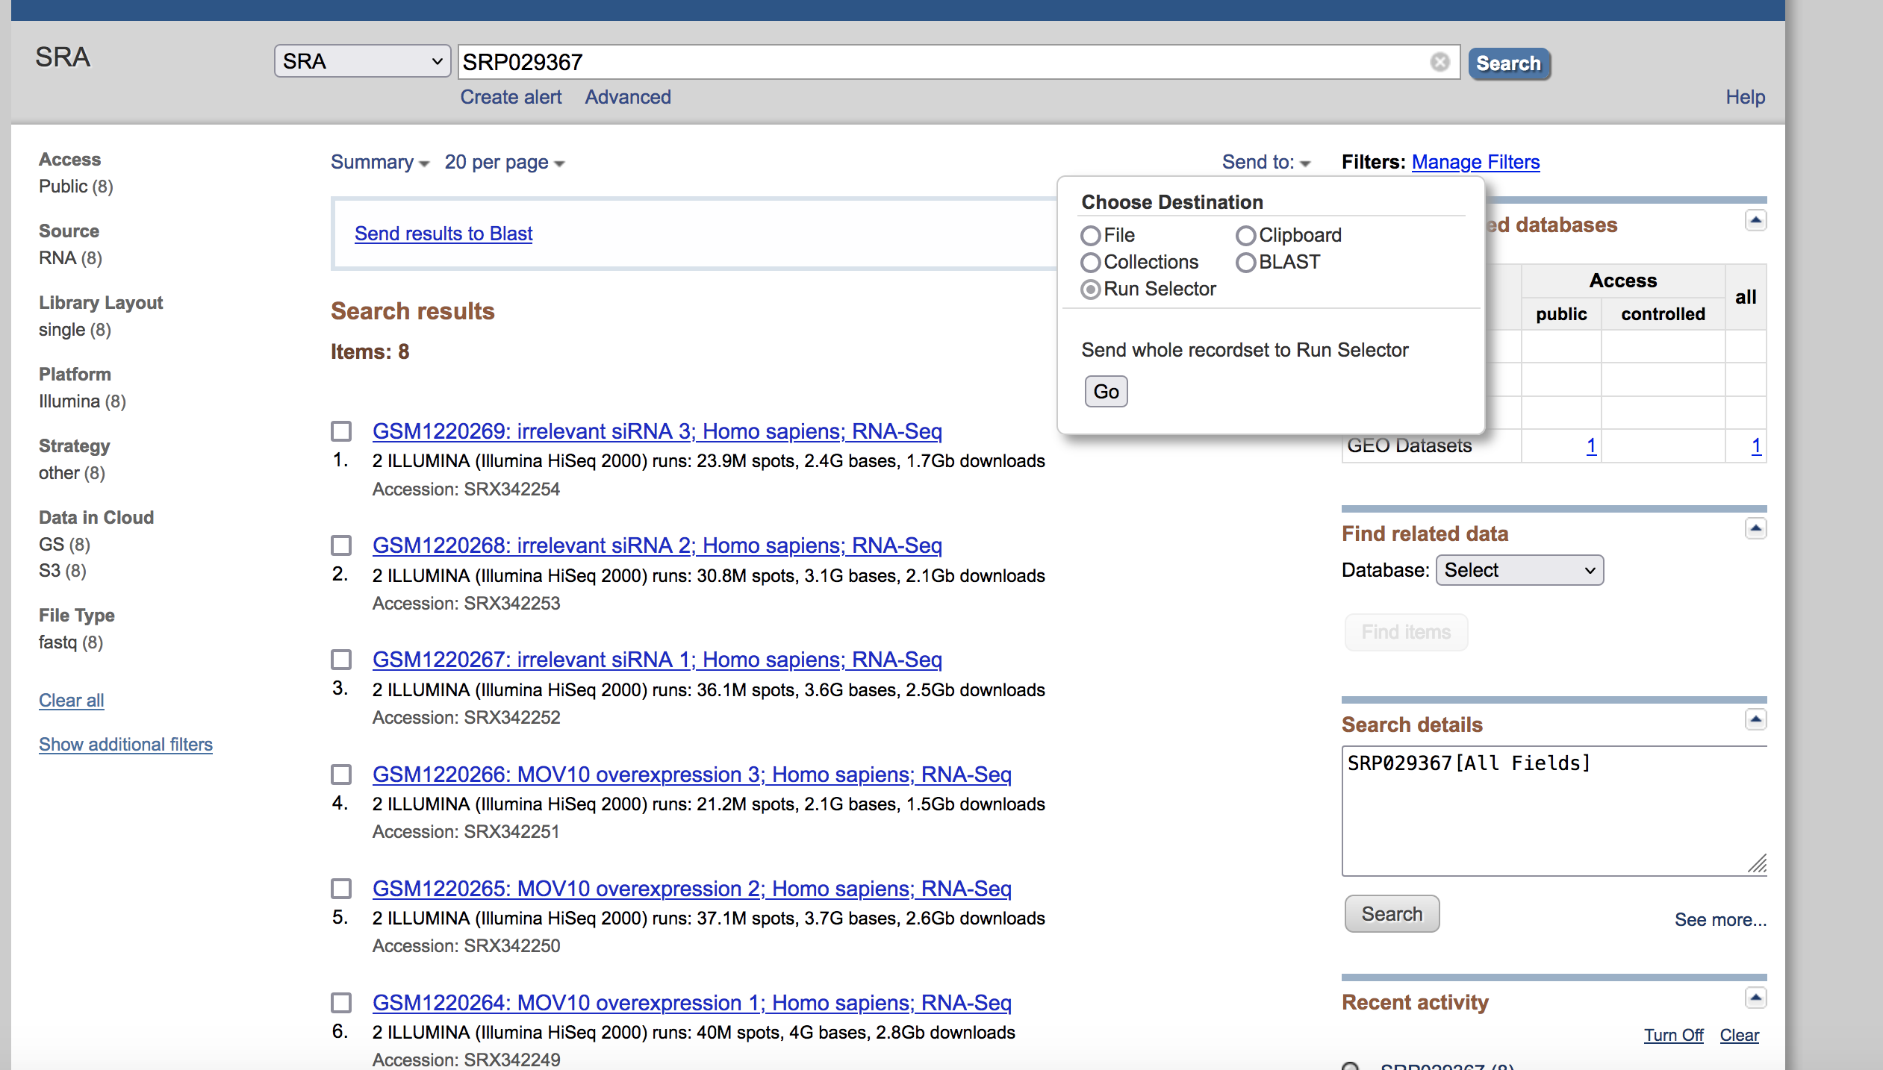
Step 1: Collect srr numbers USING RUN SELECTOR

Slide 23
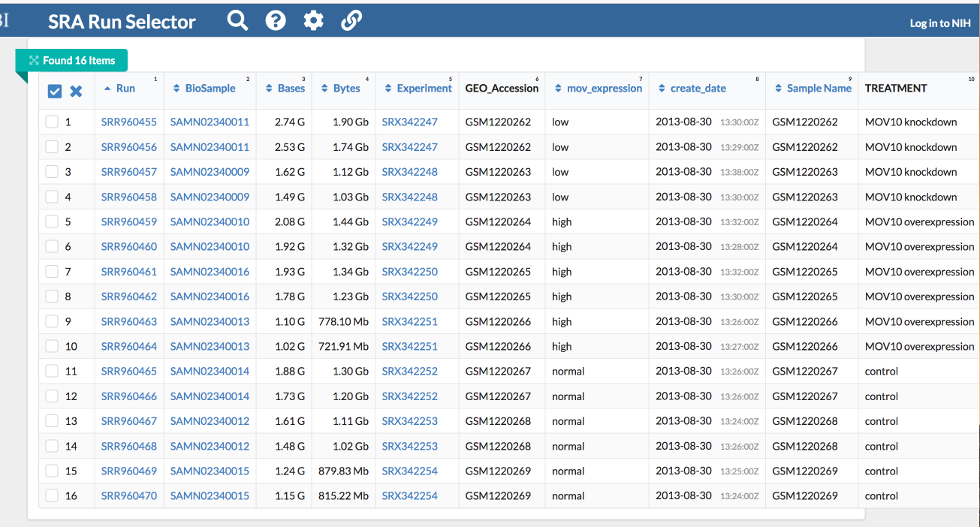
Notice, there are 8 samples however for each sample there were (2) runs making the final total 16

Slide 24
SRX342247
SRR960455
SRR960456

Slide 25
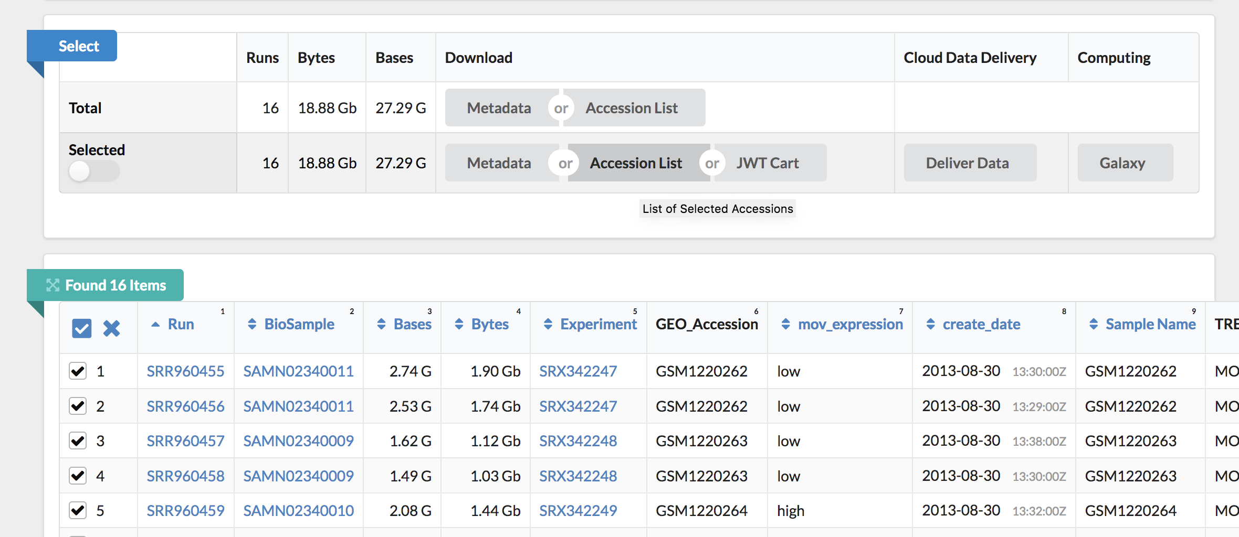

Select only the desired samples!

Slide 26
Output .txt file with list of SRR
SRR960455
SRR960456
SRR960457
SRR960458
SRR960459
SRR960460
SRR960461
SRR960462
SRR960463
SRR960464
SRR960465
SRR960466
SRR960467
SRR960468
SRR960469
SRR960470
Step #1 is complete!

Slide 27
Step 2: Download SRA-toolkit
SRA-Toolkit was developed by HPC at the NIH
Using SRA-Toolkit you will be able to download SRR FASTQ files using the fasterq-dump tool

Slide 28
How Do you run a program on the VACC?
Install it in your personal VACC account and then be able to call it
Or load it from the shared computing cluster using module package

Slide 29
How Do you run a program on the VACC?
Install it in your personal VACC account and then be able to call it
Or load it from the shared computing cluster using module package
We will do this for Alignment: HiSAT2

Slide 30
Step 2: Download SRA-toolkit
Follow Steps 1-3 under ## Download SRA-toolkit
Continue to step 4 only if you are confident

Slide 31
Environmental Variables
What are they?
How do we use them?
Why do we use them?

Slide 32
User Environmental Variables
User environmental variables are those that are local to the user profile
These variables are used to store user-specific information such as the PATH to a local installation of libraries
You do not need the system administrator (staff of VACC) to make changes to these variables, you can do this yourself as the user

Slide 33
Bash profile
Bash shell uses a few startup files to set up the environment
Bash profile is a file that Bash runs every time a new Bash session is created
This is useful because it will run certain code specific to your environment before you begin coding
Users can personalize their environment by modifying the Bash profile
In Step #4 you are adding the PATH to sratoolkit to your environment

Slide 34
PATH
PATH is an environmental variable
PATH contains a list of file system paths where the operating system can find programs to run
The operating system will look for the program in each of the paths that PATH contains, starting with the first path listed
If the operating system can’t find the program in the first path, it will look in the second path, and so on – therefore order matters!

Slide 35
echo $PATH
/users/m/m/mmg232in/miniconda3/condabin:/gpfs1/arch/spack-0.14.2/bin:/usr/local/bin:/usr/bin:/usr/local/sbin:/usr/sbin:/var/cfengine/bin:/usr/lpp/mmfs/bin:/opt/env-switcher/bin:/users/m/m/mmg232in/.local/bin:/users/m/m/mmg232in/bin:/users/m/m/mmg232in/software/sratoolkit.3.0.1-ubuntu64/bin
Each path is delimited by a colon (:)

Slide 36
Why bin folder?
The path `/bin` is usually where executable programs are stored
We will be running the program called “fastq-dump” however there are many more!

Slide 37
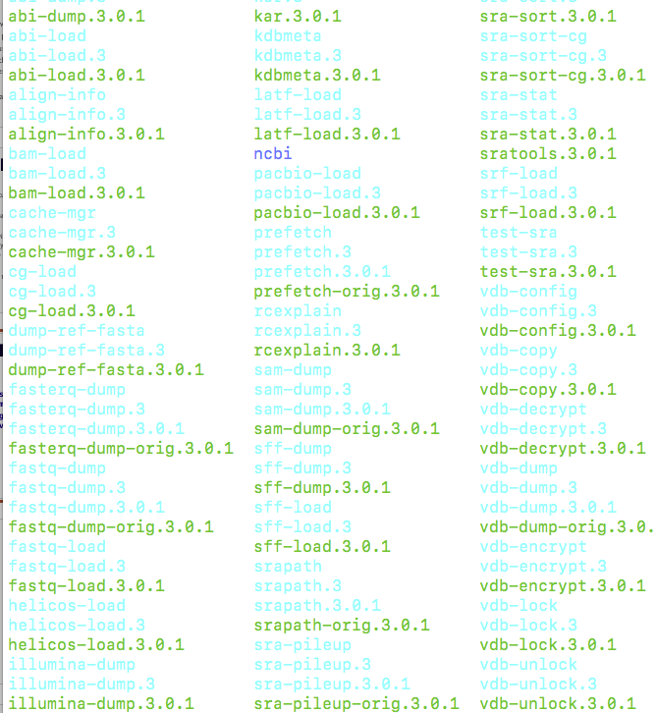
By downloading sratoolkit, we now have access to many executable programs, each with their own function.
This will be a reoccurring theme!

Slide 38
Why do this?
Every time you run a program you will need to designate the FULL PATH to the program to use it!
/users/m/m/mmg232in/software/sratoolkit.3.0.1-ubuntu64/bin/fastq-dump <inputfile>
Imagine typing that every time!

Slide 39
Why do this?
Instead, now all you have to do is type the program name!
Fastq-dump <inputfile>

Slide 40
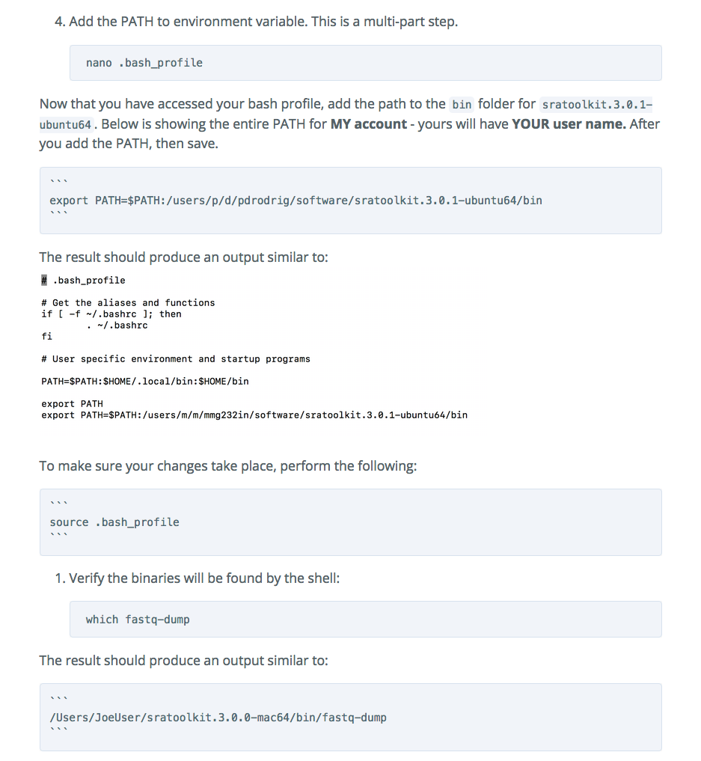
Proceed to steps 4 & 5
#5

Slide 41
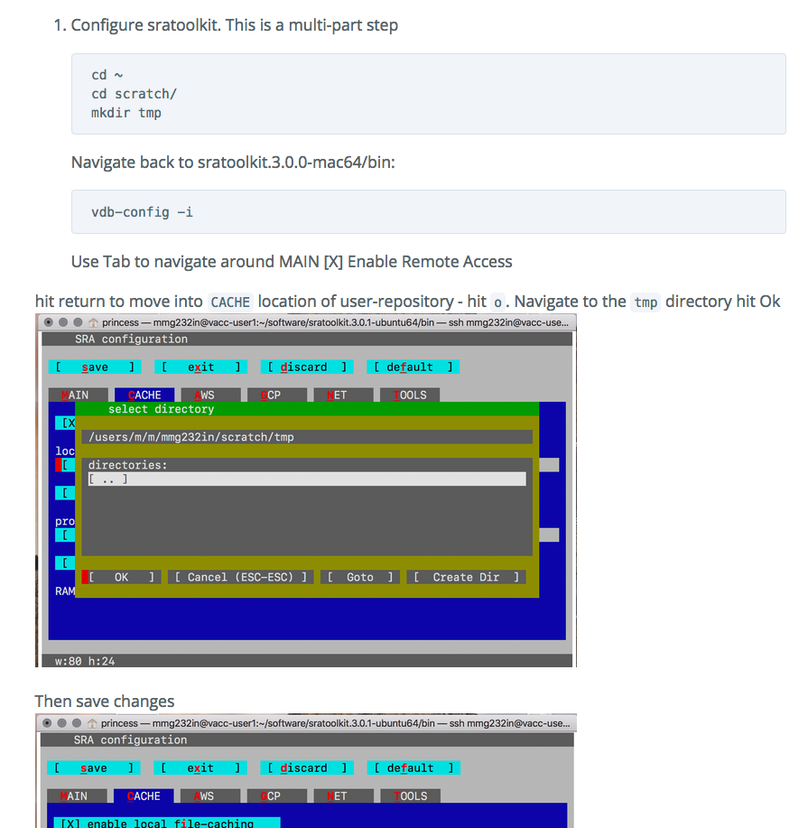
#6
I expect questions at step 6

Slide 42
STEPs to downloading data from geo:
Collect SRR Numbers using RUN SELECTOR
Download SRA-ToolKit and set up
Note: Once this is done, you do not need to do this again!
Run sra_fqdump.sh script using output from step #1
But…in order to run this script we need to submit a job using SLURM!

Slide 43
Why submit a job?
It will be annoying to run each sample, one by one:
htseq-count -f bam -s yes -i gene_name -m union sample1.bam annotation.gtf > sample1.count.txt
WAIT FOR IT TO RUN
htseq-count -f bam -s yes -i gene_name -m union sample2.bam annotation.gtf > sample2.count.txt
WAIT FOR IT TO RUN
Also, some programs…. take a very long time to run!

Slide 44

Submitting a job
Submitting a job to an HPC machine (such as Bluemoon) is done using the batch system.

Slide 45
Submitting a job
The batch system allows users to submit jobs requesting the resources (nodes, processors, memory, GPUs) that they need.
The jobs are queued and then run as resources become available.

Slide 46
Submitting a job
All jobs (scripts with file extension .sh) are submitted to a batch system called SLURM

Slide 47
BASIC STEPS:
1. Log in to VACC
2. Write job script
3. Submit Job
4. Monitor job and wait for it to run
5. Retrieve your output

Slide 48
BASIC STEPS:
1. Log in to VACC
2. Write job script
3. Submit Job
4. Monitor job and wait for it to run!
5. Retrieve your output
Requires an understanding of SLURM directives

Slide 49
WHAT ARE SLURM DIRECTIVES?
At the top of the job script will always be several lines that start with #SBATCH.
The Slurm directives provide the job setup information used by Slurm.
This information is then followed by the commands to be executed in the script.

Slide 50
Common slurm directives
#!/bin/bash
#SBATCH --partition=bluemoon
#SBATCH --nodes=1
#SBATCH --ntasks=4
#SBATCH --mem=50G
#SBATCH --time=30:00:00
#SBATCH --job-name=RNAseq
# %x=job-name %j=jobid
#SBATCH --output=%x_%j.out

Slide 51
Common slurm directives
#!/bin/bash
#SBATCH --partition=bluemoon
#SBATCH --nodes=1
#SBATCH --ntasks=2
#SBATCH --mem=50G
#SBATCH --time=30:00:00
#SBATCH --job-name=RNAseq
# %x=job-name %j=jobid
#SBATCH --output=%x_%j.out
shebang = used to tell the linux OS which interpreter to use

Slide 52
Common slurm directives
partition = default is bluemoon if not specified
Other partitions are available.
This is important to know as some jobs will take longer to run!
#!/bin/bash
#SBATCH --partition=bluemoon
#SBATCH --nodes=1
#SBATCH --ntasks=2
#SBATCH --mem=50G
#SBATCH --time=30:00:00
#SBATCH --job-name=RNAseq
# %x=job-name %j=jobid
#SBATCH --output=%x_%j.out

Slide 53
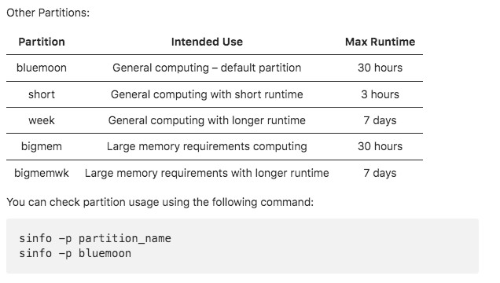

Slide 54
Common slurm directives
Node: A “node” is a server in the cluster. Each node has is configured with a certain number of cores (CPUs).
Task: A “task” is a process sent to a core. By default, 1 core is assigned per 1 task
Recommend that you begin with 1 node and 2 processes
#!/bin/bash
#SBATCH --partition=bluemoon
#SBATCH --nodes=1
#SBATCH --ntasks=2
#SBATCH --mem=50G
#SBATCH --time=30:00:00
#SBATCH --job-name=RNAseq
# %x=job-name %j=jobid
#SBATCH --output=%x_%j.out

Slide 55
Common slurm directives
#!/bin/bash
#SBATCH --partition=bluemoon
#SBATCH --nodes=1
#SBATCH --ntasks=2
#SBATCH --mem=50G
#SBATCH --time=30:00:00
#SBATCH --job-name=RNAseq
# %x=job-name %j=jobid
#SBATCH --output=%x_%j.out
If your job requires more than 1G of memory – need to specify this

Slide 56
Common slurm directives
#!/bin/bash
#SBATCH --partition=bluemoon
#SBATCH --nodes=1
#SBATCH --ntasks=2
#SBATCH --mem=50G
#SBATCH --time=30:00:00
#SBATCH --job-name=RNAseq
# %x=job-name %j=jobid
#SBATCH --output=%x_%j.out
Walltime is the maximum amount of time your job will run.

Slide 57
STEPs to downloading data from geo:
Collect SRR Numbers using RUN SELECTOR
Download SRA-ToolKit and set up
Note: Once this is done, you do not need to do this again!
Run sra_fqdump.sh script using output from step #1

Slide 58
Please download the script from this location:
cp -r /gpfs1/cl/mmg232/ course_materials/download_from_SRA .

Slide 59
Run script using:
sbatch sra_fqdump.sh

Slide 60

Check size:
du –h SRR17379677.fastq.gz
524M SRR17379677.fastq.gz

